Slide 1
Access Methods
File access is a process that determines the way that files are accessed and read into memory.
Generally, a single access method is always supported by operating systems. Though there are some operating system which also supports multiple access methods.
Three file access methods are:
Sequential access
Direct random access
Indexed sequential access

Slide 2
Sequential Access Method
A sequential access is that in which the records are accessed in some sequence, i.e., the information in the file is processed in order, one record after the other.
This access method is the most primitive one. Example: Compilers usually access files in this fashion.
Reads and writes make up the bulk of the operations on a file. A read operation—read next()—reads the next portion of the file and automatically advances a file pointer, which tracks the I/O location.
Similarly, the write operation—write next()—appends to the end of the file and advances to the end of the newly written material (the new end of file).

Slide 3
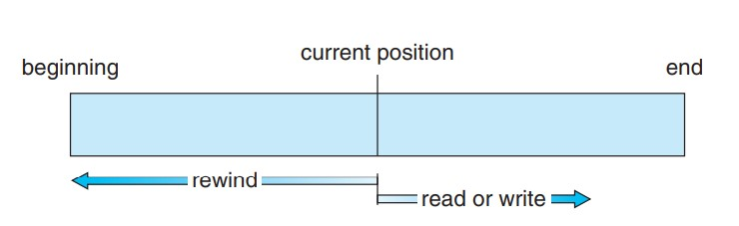
Such a file can be reset to the beginning, and on some systems, a program may be able to skip forward or backward n records for some integer n—perhaps only for n = 1.
Sequential access, which is depicted in figure is based on a tape model of a file and works as well on sequential-access devices as it does on random-access ones.
Fig: Sequential access file

Slide 4
Random Access/ Direct Access
The random access method is also called direct random access.
Random access file organization provides, accessing the records directly.
Each record has its own address on the file with by the help of which it can be directly accessed for reading or writing.
The records need not be in any sequence within the file and they need not be in adjacent locations on the storage medium.
Read n: reading record n
Write n: writing record n
Jump to record n
Query current record: used to return back to this record later

Slide 5
Indexed sequential access/Index Access
This type of accessing method is based on simple sequential access.
In this access method, an index is built for every file, with a direct pointer to different memory blocks.
This method, the Index is searched sequentially, and its pointer can access the file directly.
Multiple levels of indexing can be used to offer greater efficiency in access. It also reduces the time needed to access a single record.

Slide 6
Structure of directory
Directory can be defined as the listing of the related files on the disk.
The directory may store some or the entire file attributes.
To get the benefit of different file systems on the different operating systems.
A hard disk can be divided into the number of partitions of different sizes. The partitions are also called volumes or mini disks.
Each partition must have at least one directory in which, all the files of the partition can be listed.
A directory entry is maintained for each file in the directory which stores all the information related to that file.

Slide 7
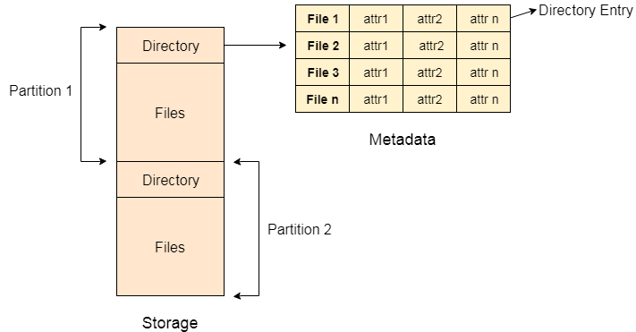

Slide 8
Every Directory supports a number of common operations on the file:
File Creation
Search for the file
File deletion
Renaming the file
Traversing Files
Listing of files

Slide 9
Single level Directory
The simplest method is to have one big list of all the files on the disk.
The entire system will contain only one directory which is supposed to mention all the files present in the file system.
The directory contains one entry per each file present on the file system.
This type of directories can be used for a simple system.

Slide 10
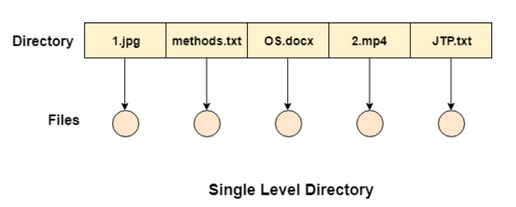

Slide 11
Advantages
Implementation is very simple.
If the sizes of the files are very small then the searching becomes faster.
File creation, searching, deletion is very simple since we have only one directory.
Disadvantages
We cannot have two files with the same name.
The directory may be very big therefore searching for a file may take so much time.
Protection cannot be implemented for multiple users.
There are no ways to group same kind of files.
Choosing the unique name for every file is a bit complex and limits the number of files in the system because most of the Operating System limits the number of characters used to construct the file name.

Slide 12
Two Level Directory
In two level directory systems, we can create a separate directory for each user.
There is one master directory which contains separate directories dedicated to each user.
For each user, there is a different directory present at the second level, containing group of user's file.
The system doesn't let a user to enter in the other user's directory without permission.

Slide 13
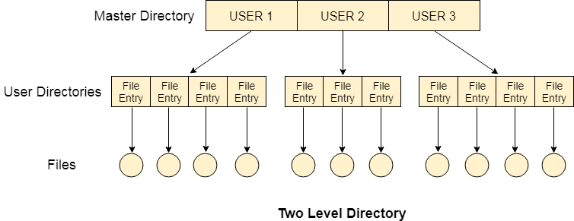

Slide 14
Characteristics of two level directory system
Each files has a path name as /User-name/directory-name/
Different users can have the same file name.
Searching becomes more efficient as only one user's list needs to be traversed.
The same kind of files cannot be grouped into a single directory for a particular user.
Every Operating System maintains a variable as PWD which contains the present directory name (present user name) so that the searching can be done appropriately.

Slide 15
Tree Structured Directory
In Tree structured directory system, any directory entry can either be a file or sub directory.
Tree structured directory system overcomes the drawbacks of two level directory system.
The similar kind of files can now be grouped in one directory.
Each user has its own directory and it cannot enter in the other user's directory. However, the user has the permission to read the root's data but he cannot write or modify this.
Only administrator of the system has the complete access of root directory.
Searching is more efficient in this directory structure. The concept of current working directory is used.

Slide 16
A file can be accessed by two types of path, either relative or absolute.
Absolute path is the path of the file with respect to the root directory of the system while relative path is the path with respect to the current working directory of the system.
In tree structured directory systems, the user is given the privilege to create the files as well as directories.

Slide 17
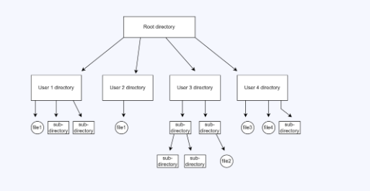

Slide 18
Advantages of tree-structured directory
Highly scalable compared to the previous two types of directories.
Allows subdirectories inside a directory.
Searching is easy.
Allows grouping.
Segregation of important and unimportant files is easy.
Disadvantages of tree-structured directory
As one user cannot enter another user’s directory, this restricts sharing of files.
Too many subdirectories may make the search complicated.
Users cannot modify the root directory’s data.
Files might have to be saved in multiple directories in case all of them do not fit into one.

Slide 19
Permissions on the file and directory
A tree structured directory system may consist of various levels therefore there is a set of permissions assigned to each file and directory.
The permissions are R W X which are regarding reading, writing and the execution of the files or directory.
The permissions are assigned to three types of users: owner, group and others.
There is a identification bit which differentiate between directory and file. For a directory, it is d and for a file, it is dot (.)

Slide 20
Acyclic-Graph Structured Directories
The tree structured directory system doesn't allow the same file to exist in multiple directories therefore sharing is major concern in tree structured directory system.
We can provide sharing by making the directory an acyclic graph.
In this system, two or more directory entry can point to the same file or sub directory. That file or sub directory is shared between the two directory entries.
These kinds of directory graphs can be made using links or aliases.
We can have multiple paths for a same file. Links can either be symbolic (logical) or hard link (physical).

Slide 21
If a file gets deleted in acyclic graph structured directory system, then
1. In the case of soft link, the file just gets deleted and we are left with a dangling pointer.
2. In the case of hard link, the actual file will be deleted only if all the references to it gets deleted.

Slide 22
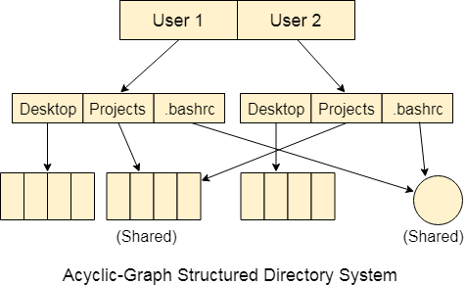

Slide 23
Advantages of acyclic- graph directory
Allows sharing of files or subdirectories from more than one directory.
Searching is very easy.
Provides more flexibility to the users.
Disadvantages of acyclic-graph directory
Harder to implement in comparison to the previous three.
Since the files are accessed from multiple directories, deleting a file may cause some errors if the user is not cautious.
If the files are linked by a hard link, then it is necessary to delete all the references to that file to permanently delete the file.

Slide 24
General Graph Directory
Cycles are allowed inside a directory structure where numerous directories can be derived from more than one parent directory in a general graph directory structure.
When general graph directories are allowed, commands like search a directory and its subdirectories for something must be used with caution.
If cycles are allowed, the search is infinite.
The biggest issue with this type of directory layout is figuring out how much space the files and folders have used up.

Slide 25
Advantages of General Graph Directory
The General-Graph directory structure is more adaptable than the others.
In the general-graph directory, cycles are permitted.
Disadvantages of General Graph Directory
It is more expensive than other options.
Garbage collection is required.

Slide 26
